Slide 1


Welcome
Class of 2025
Sunrise Mountain High School
Junior Presentation

Slide 2
Introductions…
Counselors:
Mrs. Cetta
Mrs. Jans
Mrs. Fuhrmann
Mrs. Rizer
Ms. Ryan
Secretary: Mrs. Smith
Career Center: Ms. Baker
Records Office: Mrs. Olson
Transcripts

Slide 3
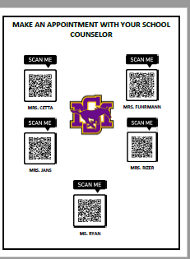
How to Get help…
Counselors:
  Academic Planning
  College/Career
  Social/Emotional
  Make an appointment
  Send an Email

Slide 4

How to Get Help/Information
    I need help with….
  Career Center (Library) – Ms. Baker
    Dual Enrollment
    College Visits
    Scholarships
      Appointment link
  Mr. Massey, Social Worker (Library)
    Social/Emotional
      Appointment link
    Where to get Information…
  Emails home to parents from Administration/Sway/Parentsqure
  Facebook
  2nd hour Student Announcements
  Guidance Website (in progress)
  School email (occasional reminders from counselors)

Slide 5




college Information
University requirement- 3.0 core GPA, top 25% of class, 16 core classes, *2 years of world language
Start researching colleges / visits
Career Center- meet with Reps
College Night – October 18th at Centennial High School – TBD

Slide 6
college Information
PSAT – Priority deadline was Friday for juniors
  Sign up in bookstore
  October 4th – afternoon
Take the ACT in the spring here!!!
  Study guides/materials available – ACT.org
SAT – College Board to register for a test
  Study guides/materials available – Collegeboard.com
Some Colleges Don’t Require SAT/ACT so do your research!

Slide 7





Other options…
Community College
* More affordable
* Presidential Scholarship
Trade and Tech Schools
* Specific training
* Shorter time
Military
* Take the ASVAB (Career Center)
* Study guide online

Slide 8



Athletes looking to play in college
Please discuss your desire with your coach.
Go to the NCAA Eligibility Center
See your counselor if you have more questions.

Slide 9

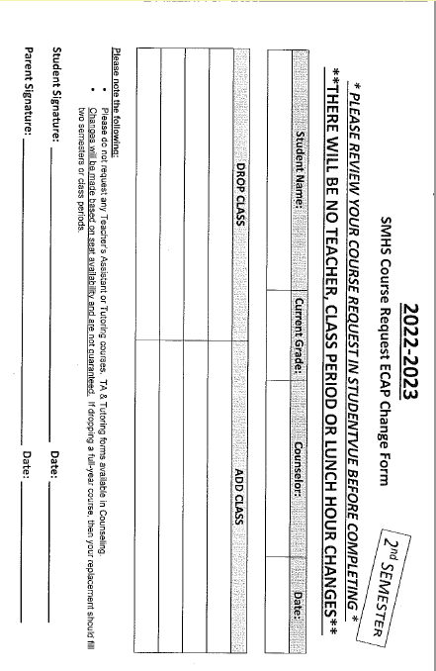

Check Spring Courses:
In Studentvue:
Go to schedule and then click Term 3.
Check math placement
Tutor /TA – form in guidance
eCampus – can register now
Changes must be made now!
We will not make any changes in January.

Slide 10
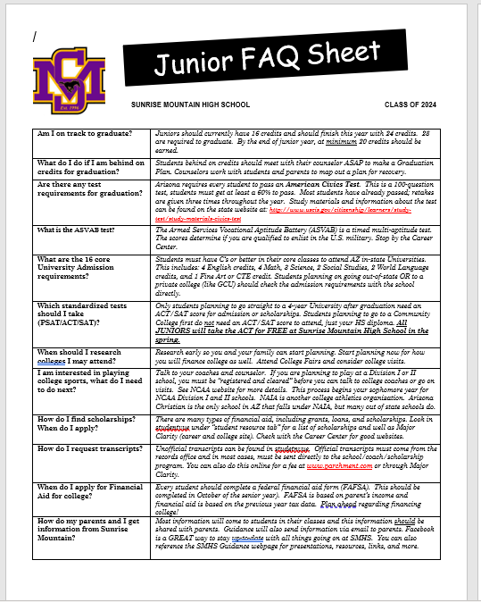
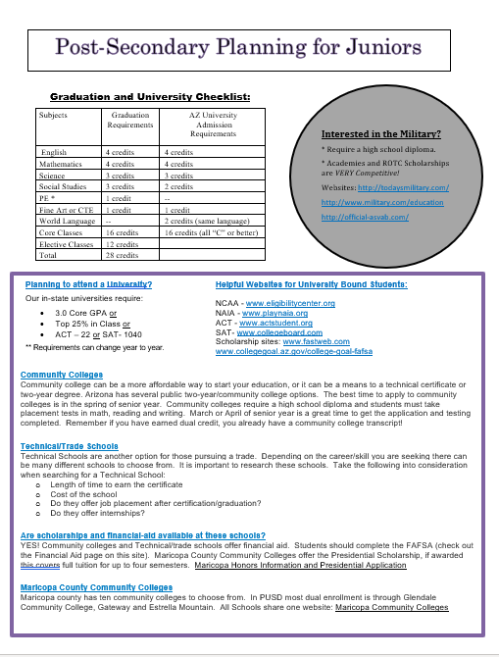
Junior Information – FAQ

Slide 11
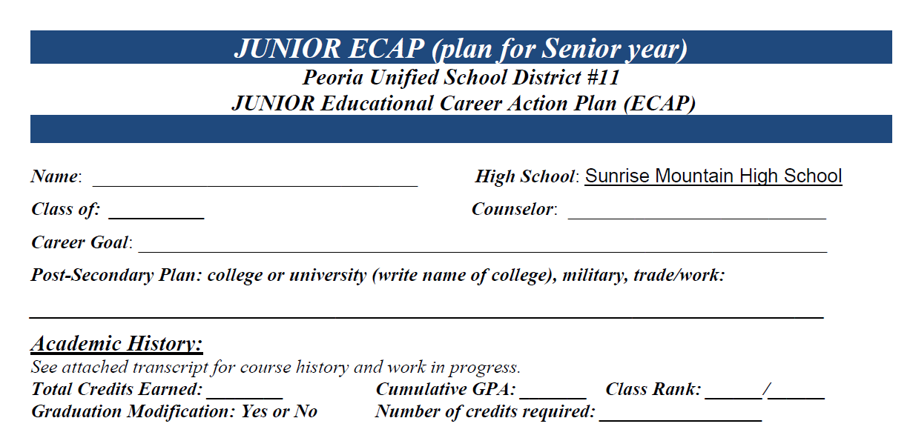
Complete Your Registration
Fill out the top
  Name, Class Of, Counselor, Career Goal, &
  Post-Secondary Plans
Academic History- use
your transcript to complete

Slide 12
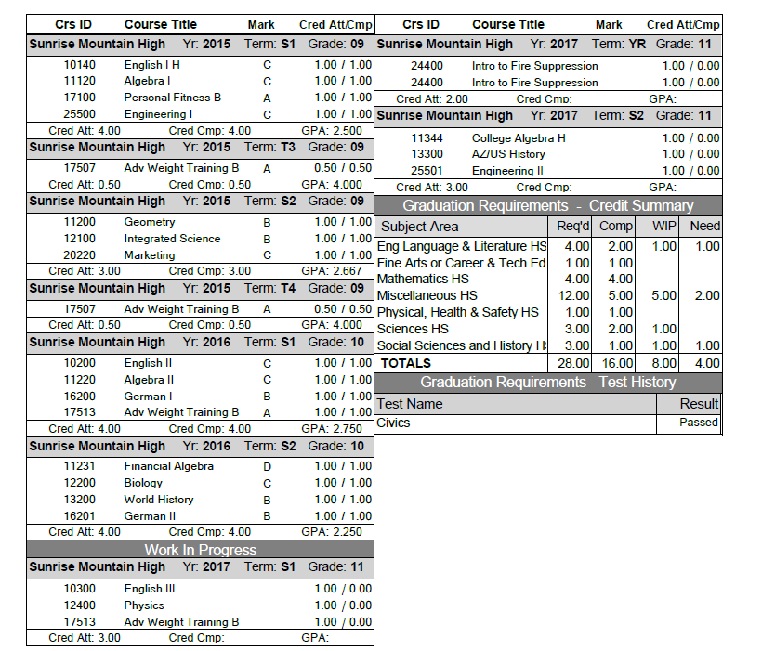
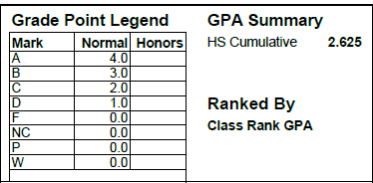
Your Transcript
What is your GPA?
What is your Class Rank?
Did you pass Civics?
How many credits have you earned so far? See Summary Box.
How many credits do you need to graduate? Is it different than 28, because you didn't begin as a freshman at Sunrise?
Is it less than 16? You are not on track to graduate… see your counselor!
Missing credits: WestMec, MET, eCampus, Tutor

Slide 13
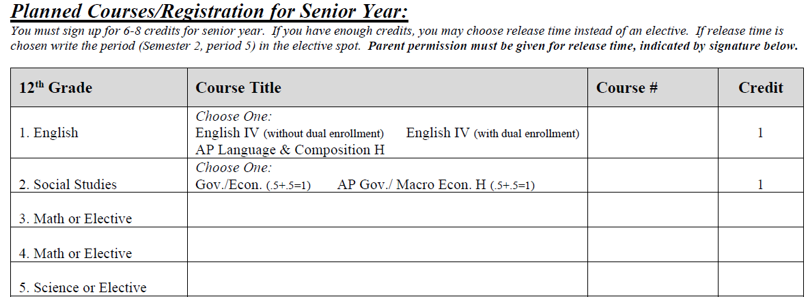
Pre-register for senior classes
English
  English IV (dual credit optional)
  AP Language & Comp Honors
Economics & Government
  Regular Gov/Econ
  AP Government/AP Macro Economics
  Science
  Make sure you have completed 3 science credits
  Math
  Make sure you have completed 4
  math credits
Circle
Math/Science or
Elective

Slide 14




Senior Only Classes
JAG- Jobs for Arizona Graduates
Patient Care/ Patient Care Lab (if you have completed Intro to health care)
Professional Internship- 135 hours in any field/career of interest
Intro to Fire Selection (if you have successfully completed Intro to Fire Suppression)

Slide 15

Peer Counseling
Do you enjoy supporting others?
Would you be a positive mentor for new students?
Have you thought about counseling, psychology, social work or other helping professions as a career?
Are you interested in assisting with anti-bullying and suicide prevention?
If so... think about being a peer counselor and get an application.

Slide 16
Additional Schedule Information
​Application/Try out Classes:
(list as alternate)
Student Council
Yearbook
Unified Sports/Arts
Peer Counseling
Performance Dance
Co-Enrollments
MET/ WestMec (unless currently in )
How to Co-Enroll at another School:
Fill out the form and you will be added to a list for the district.
Many programs are full.
You will be notified in May if you got in.
List as an alternate
​Athletes (sign up for sports class):
JV and Varsity Athletes: you will write weight training with the sport
Ex. “Football Weights”, “Baseball Weights”, “Varsity Girls Weights”
See specific codes on course offering guide
Write it down ONCE OR TWICE
*** If you are NOT on a team you will put beginning weights down.

Slide 17


MET Academy
Peoria High School
One Year Programs

Slide 18

2024-25 one-year PROGRAMS * subject to change ​
Aesthetics
Air Conditioning
Electrical Trades
General Construction
Medical Assisting
Nursing Services
Pharmacy Technician
Veterinary Sciences
Environmental Sustainability
Physical Therapy
Culinary Principles
EMT
Fire Science
Drone
Masonry
HOW TO APPLY…
https://west-mec.edu/
Applications open in the fall (usually October) and the deadline is the day before Winter Break.
Open Houses!!!

Slide 19
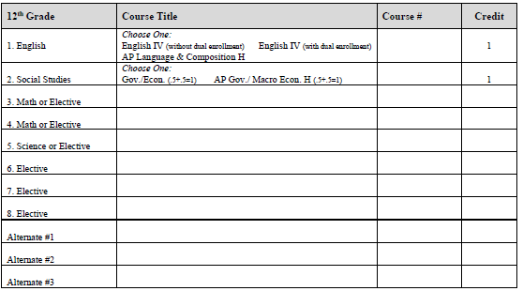
Electives
You will be registering for a minimum of 6 classes.
You will add 3 alternates
If you have earned release time- use line 7 & 8- Must have parent signature for this!!!
Fill in every line- no exceptions
Be sure to Sign the back
Circle one
Math or Elective
Science or Elective
Release time list hour/ line 7 and 8
Don’t leave blank
Application and Try Out Classes Go Here ALTERNATE

Slide 20

Recap on your ecap/Registration.....
All ECAPS must be complete and signed by a parent.
Meet SMHS graduation requirements!
Check college requirements, if attending.
Finish your Registration/ECAP by Monday, September 25th .
Reminder: Make wise selections, as there will be NO elective changes made after February 14th.

Slide 21
Meet with Counselors… bring completed ECAP
Monday, September 25th
  All English classes
  Student w/ passes from other classes
Tuesday, September 26th
  All History classes

